Slide 1
Computational Resources @ UW-Madison
Elizabeth McDaniel
2019-08-27
MDTP Orientation

Slide 2
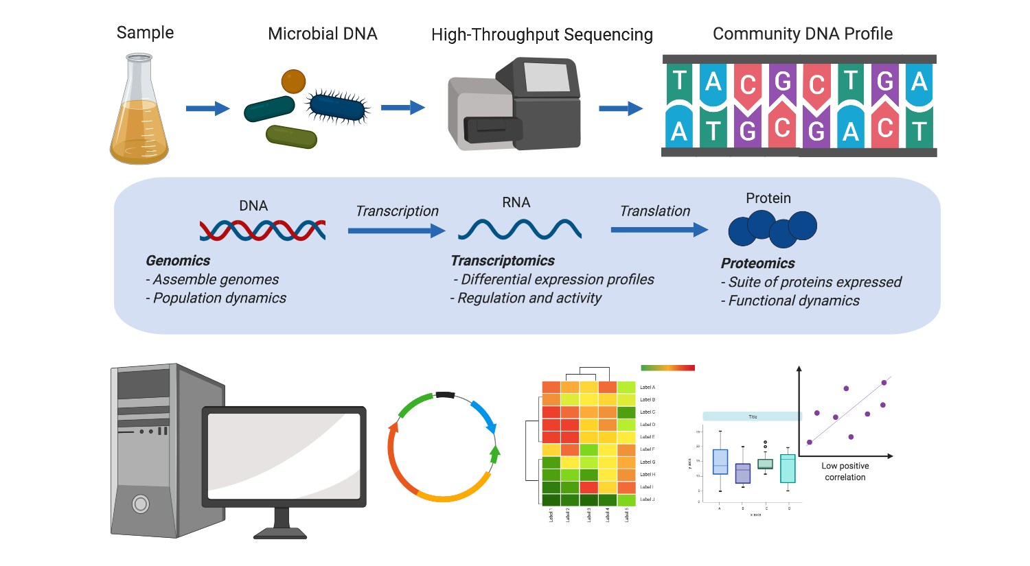
Why should I learn computational skills?

Slide 3
Why should I learn computational skills?

Slide 4
Why should I learn computational skills?
Science careers annual postdoc survey, COMPASS

Slide 5



Why should I learn computational skills?
Data science/computational skills are highly transferrable and sought after
Era of “big-data” in personalized medicine, microbiome therapeutics, & genomics start-ups
Government agencies rely on data analysts for public health programs & energy applications

Slide 6
How can I learn computational skills?
Method of Learning | Pros | Cons
Formal coursework | Formal education on programming language | Homework Classes don’t address relevant skills/workflows
Programming Books | Learn at your own pace | $$$ Requires self-motivation
Online courses | Learn at your own pace Learn in your PJs | Sometimes $$$
Locally-held workshops | Usually free or low cost Gives you transferrable and useable skills immediately | Held during certain times of the year
Study groups/communities of practice | Discuss with others doing similar work how to perform common analyses | Not a formal class with learning objectives
Campus Core Services/Libraries/Hubs | Weekly office hours for specific help Make connections to other campus resources | Sometimes consultation requires $$$

Slide 7
Formal Coursework @ UW-Madison
MICROBIO 657: Bioinformatics for Microbiologists
Spring Semester, Garret Suen (possibly not offered in 2020)
STATS 679: Computing Tools for Data Analytics
Fall Semester, Cecil Ane
BMI 541: Introduction to Biostatistics
BMI 576: Introduction to Bioinformatics
BMI 776: Advanced Bioinformatics
CS301: Introduction to Data Programming

Slide 8
Programming/Bioinformatics Books

Slide 9
Programming/Bioinformatics Books

Slide 10
Programming/Bioinformatics Books

Slide 11
Online Courses
Range of coursework from basic programming in R/python
Official courses from Harvard/MIT offered on edX in machine learning concepts/advanced bioinformatics
If all else fails; Google it

Slide 12
The Carpentries

Slide 13
Carpentry Workshops on Campus
Workshops focused on teaching reproducible computational practices
Data Carpentry: Project organization skills, SQL, R
Software Carpentry: Unix shell, Python, and version control (git)]
Large community of local instructors
R workshops will be held weekly during Fall semester starting September 11th
Both carpentries workshops usually held in January over winter break
For updates about registration and other computation/data science events on campus: join-dshubcommunity@lists.wisc.edu

Slide 14
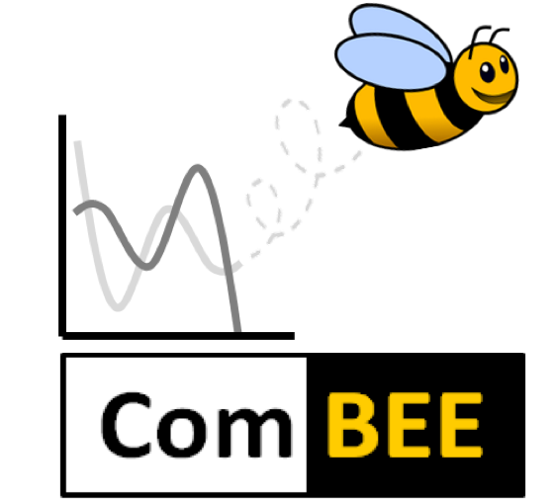
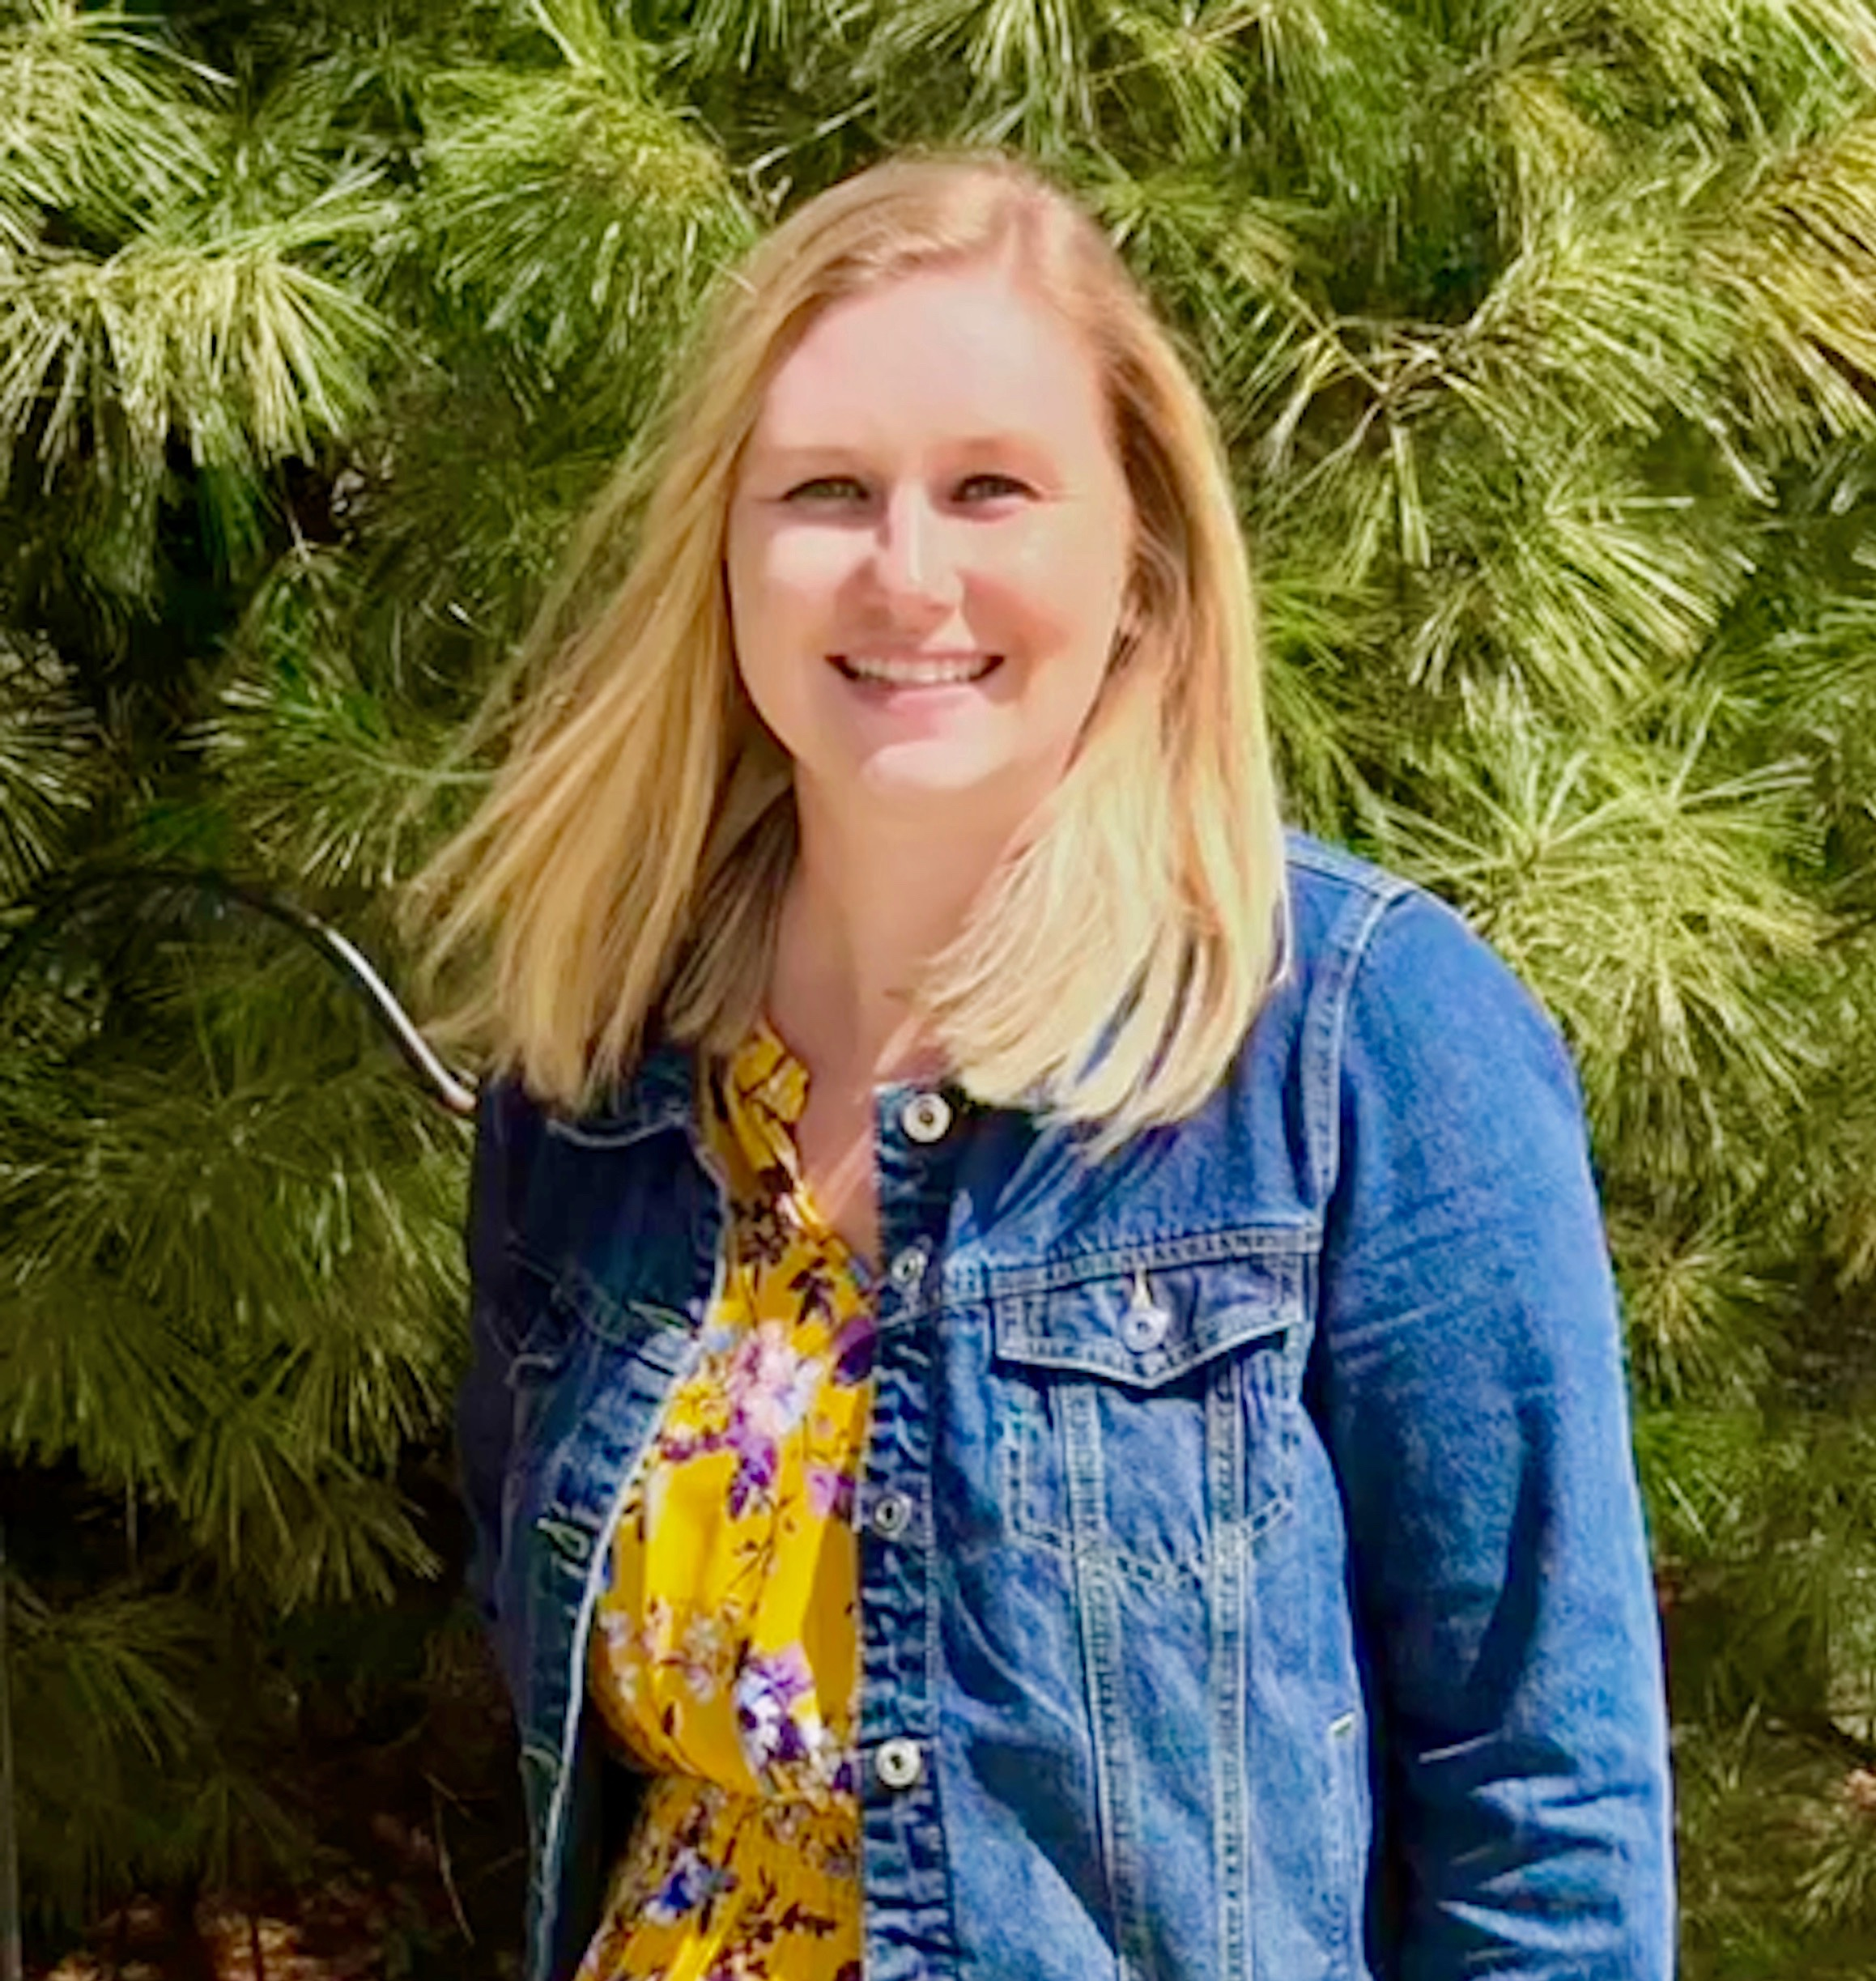
ComBEE
Computational Biology, Ecology & Evolution
Community of practice, student organized group to provide support for researchers applying computational tools to their research in ecology/evolution
Monthly seminars on computational biology/theoretical ecology/evolution
Weekly study groups on ‘omics related topics
Social gathering on Sept. 6th @ 4PM in MSB 6201
join-combee@lists.wisc.edu
https://combee-uw-madison.github.io
Kirsten Gotting – Currie Lab (Genetics Program)
Elizabeth McDaniel – McMahon Lab (MDTP)

Slide 15
Quantitative Biology Initiative
Initiative to bring together quantitative biology on campus
Holds weekly seminars: https://wid.wisc.edu/seminars/qbio/
Minor in Quant Bio: https://qbi.wisc.edu/education/phd-minor/
https://qbi.wisc.edu/

Slide 16

Steenbock Libraries Workshop Series
R workshop series and an Open Coding Lab (coding office hours/hacky hour) during the Fall semester
R workshop series covering R basics, data wrangling, visualization
Expanded R workshops for researchers
Hosted in the Biocommons in Steenbock
https://github.com/maglet/uw-r-workshops
Tobin Magle
tobin.magle@wisc.edu
Research Data Services Facilitator
Steenbock Libraries

Slide 17
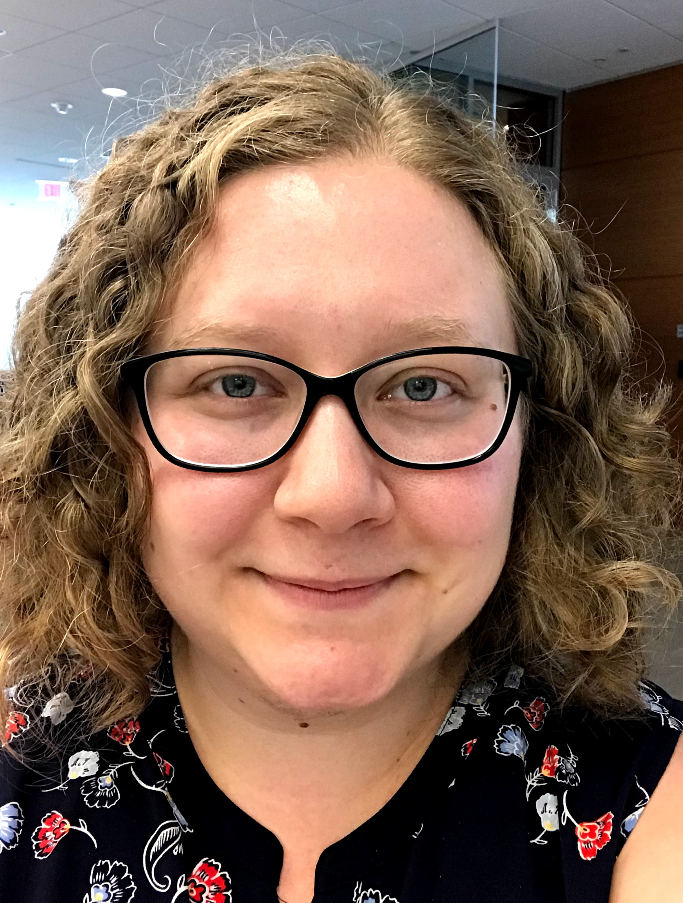
Data Science Hub
First stop for all data science related questions
Hosts carpentries and data science training workshops
Building a data science community and facilitating interdisciplinary collaborations
http://datascience.wisc.edu
Find out about events, workshops, professional development trainings, how to get involved by joining the Data Science Hub listserv: join-dshubcommunity@lists.wisc.edu
Sarah Stevens
Data Science Facilitator
facilitator@datascience.wisc.edu

Slide 18

Microbiome Hub
Services and consultation concerning:
Experimental design
Data analysis
Coordinating collaborative research
Data management
Developing workshops, teaching modules, seminar series and conferences
Conducting outreach activities
https://microbiome.wisc.edu
Sailendharan Sudakaran
Manager
madmicrobiome@wid.wisc.edu
@madmicrobiome

Slide 19
Biotech Center Workshops
Biotech center on campus offers Bioinformatics workshops (usually costs $$$)
Workshops include:
Linux Basics for NGS Data Analysis
Intro to NGS Data Analysis
16S Amplicon Sequencing Processing & Analysis
RNAseq Analysis
Single-cell RNA-seq
ChIPseq
http://www.biotech.wisc.edu/services/brc/workshop

Slide 20
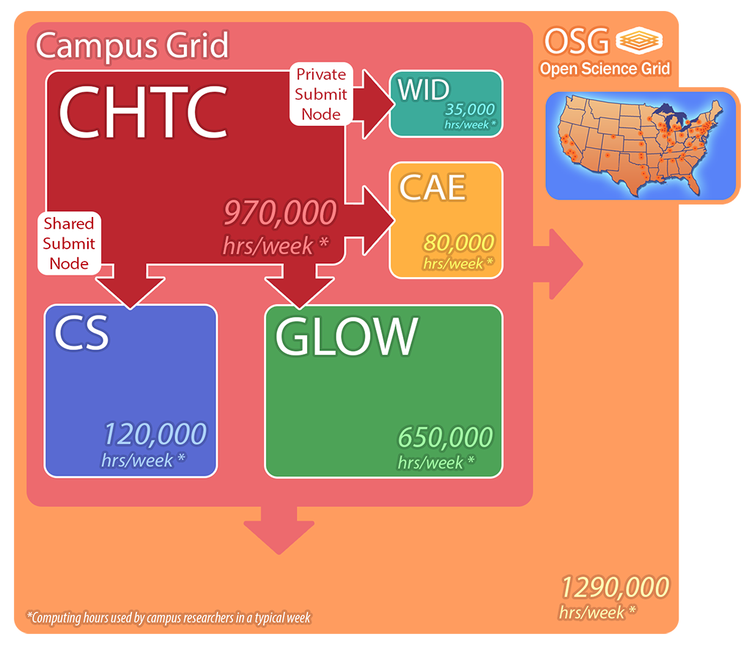
Center for High Throughput Computing (CHTC)
Free, campus resource
Scale up your computational research from your laptop
Can run more analyses in parallel and larger jobs using their resources
Facilitators who can help you get started – weekly office hours
https://chtc.cs.wisc.edu
Lauren Michael
Research Computing Facilitator
lmichael@wisc.edu
Christina Koch
Research Computing Facilitator
ckoch5@wisc.edu

Slide 21
Questions?
Elizabeth McDaniel
McMahon Lab – main office space in Engineering hall
emcdaniel@wisc.edu
Fliers with computational resources, ComBEE monthly seminar schedule for the Fall semester
ComBEE Social on September 6th @ 4PM in MSB 6201!

